Slide 1
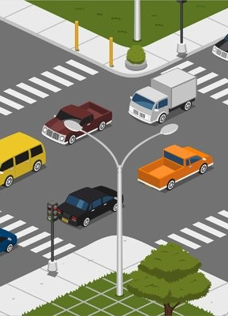
Neuro Fleet X – AI Powered Urban Fleet & Traffic Intelligence
INFOSYS SPRINGBOARD VIRTUAL INTERNSHIP 6.0
JAVA BATCH – 7
TEAM - B

Slide 2
PROBLEM STATEMENT
Cities are becoming more crowded with a rapidly increasing number of vehicles
In the future, roads will have both human-driven and autonomous vehicles
Managing all vehicles together is becoming very complex
Limitations of current traffic systems
Cannot handle sudden traffic congestion
Do not predict high-risk or accident-prone zones
Lack safe and intelligent route guidance
Cannot monitor vehicles continuously in real time

Slide 3
SCOPE OF PROJECT
Manage all vehicles (normal & autonomous)
Monitor traffic flow and risk zones
Track vehicle movement in real time
Support Admin, Manager, and Driver roles
Show congestion and safe routes using maps

Slide 4
Team Members & Roles – Team B
Ganesh – LOGIN & Admin Module
Narmadha L – Admin Module
Nithin – Manager Module
Dinesh – Driver Module

Slide 5
DELIVERABLES
Fully functional web application developed using react and spring boot
Secure backend APIs with authentication and authorization
Role-based access system supporting three user roles:
  Admin
  Manager
  Driver
Dedicated dashboards for each role with controlled access
Live traffic and vehicle status updates
Ai-assisted features for:
  Traffic congestion detection
  High-risk location identification
  Safe and efficient route suggestions

Slide 6
Admin
Manager
Driver
Full control of the system
Manages users (Admins, Managers, Drivers)
Manages vehicles
Views dashboards, alerts, and AI analytics
Monitors traffic and risk zones
Updates traffic data
Manages fleet status
Handles traffic-related alerts
Creates and views trips
Follows suggested routes
Shares live location (GPS)
Receives traffic and safety alerts
Admin → Controls everything
Manager → Monitors and manages traffic
Driver → Uses routes and drives safely

Slide 7
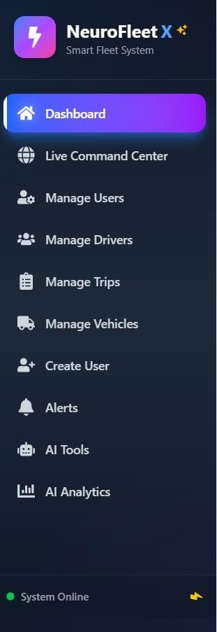
ADMIN:
Dashboard
view overall system status including vehicles, traffic conditions, and risk zones in one place.
Manage & Create users
create and manage admins and managers, assign roles, and control system access.
Manage drivers
add, update, view, and archive driver details such as license, contact, and experience.
Manage vehicles
add, edit, delete, and monitor vehicles, including their status and assignment.
Alerts
create new alerts, view all system alerts, and resolve traffic or risk-related issues.
Ai tools
use ai-based features such as route suggestions and traffic analysis support tools.
Ai analytics
monitor traffic risk levels, congestion patterns, and analytics data using charts and visual indicators.

Slide 8
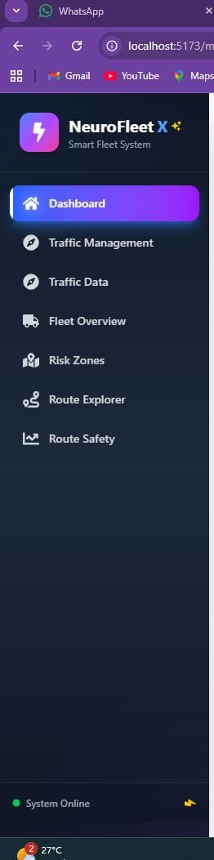
MANAGER ROLE
Dashboard – view traffic status, fleet overview, and risk zones
Traffic management – add and update traffic data for different locations
Risk zone monitoring – identify low, medium, high, and critical risk areas
Fleet overview – monitor active, idle, and stuck vehicles
Route explorer – view different possible routes between source and destination
Route safety – analyze safety level of routes before assigning trips

Slide 9
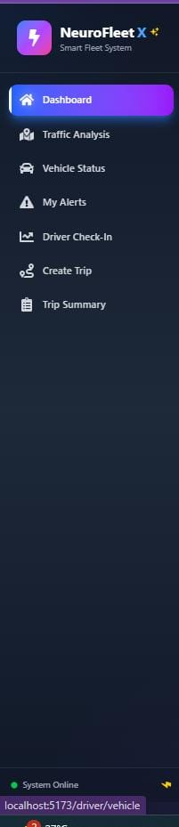
DRIVER ROLE
Dashboard – view overall trip information, traffic status, and quick updates
Traffic analysis – view current traffic conditions and congestion levels
Vehicle status – check assigned vehicle health and status details
My alerts – receive and view traffic, safety, and risk alerts
Driver check-in – manually update current location during trips
Create trip – create a new trip with source and destination details
Trip summary – view completed trip details including route, duration, and status

Slide 10
CONCLUSION
Neuro fleet x is a smart fleet and traffic management system designed for admin, manager, and driver roles.
It helps monitor vehicles, traffic conditions, risk zones, and alerts in real time.
With basic ai-assisted features like congestion analysis, risk detection, and route suggestions, the system improves traffic awareness and decision-making.
Overall, the project provides a strong base for building more advanced intelligent traffic solutions in the future.

Slide 11
THANK YOU.....

